Slide 1


2401FT_DS | Python Week 2
8 April - 10 May
Marc & Ereshia

Slide 2
01.
Announcements
02.
Version Control
03.
Git
04.
Python Functions
05.
Q&A

Slide 3
Announcements
Things to remember…
Assessments due this week:
17 April 23:59pm CAT: Loops and functions [Code Challenge]
19 April 23:59pm CAT: Sort, Recursive functions, lambda functions and OOP [MCQ]
Pod Sessions are now 45 min long (your pod session time may have changed)
Friday weekly retrospectives
We are looking into the code challenge issue regarding the asset folder.

Slide 4
01.
Announcements
02.
Version Control
03.
Git
04.
Python Functions
05.
Q&A

Slide 5
Version Control
Version vs Versioning
Version
Versioning
This is a specific instance of a program or file, it is usually identified by a specific number, word or phrase.
An example is Android 13 or I.O.S. 17
The process creating, managing and tracking the versions of a program or file over time.
In this process, the team record the changes made and assign the new version a unique identifier.

Slide 6
Version Control
Version History
Version history is the chronological record of all the changes made to a program or file.
It records : who? what? When?
The ‘who?’ is the authors’ information.
The ‘what?’ is what are the changes made and the unique identifier given to the new version.
The ‘when?’ is the date and time of the changes.

Slide 7




Version Control
Version Control Systems
These are systems that allow us to track the state of our program and files as they change over time.
These systems allow multiple people to collaborate on the project in parallel.
Git
Bazaar
Mercurial
Darcs

Slide 8
Version Control
Why do we use a DVCS?
Clarity
Traceability
Accountability
Ability to clearly identify each version and the changes associated with each version
Ability to track all the changes made to the code
Links the changes to contributors at a certain time
Error Handling
Availability
Enable error handling with minimal disruption to the other collaborators
The latest stable version of the program or file is always online.

Slide 9
01.
Announcements
02.
Version Control
03.
Git
04.
Python Functions
05.
Q&A

Slide 10
Git
Git and GitHub
Git
GitHub
It is a distributed version control system (DVCS)
The entire repository is copied onto your local machine
Flexible, fast, optimised for branching.
It is a web-based collaborative platform
The repositories are hosted online.
Collaboration features, social coding, continuous integration, hosting assets, access control

Slide 11
Git
Basic Terminology
Repository
A central location to store all the code and assets for a project.
Commit
A checkpoint of the code and assets at a specific point in time
Branch
An independent copy of the main project within the repository, mainly allows for isolation.
Merge
The process of combining the changes made in different branches

Slide 12
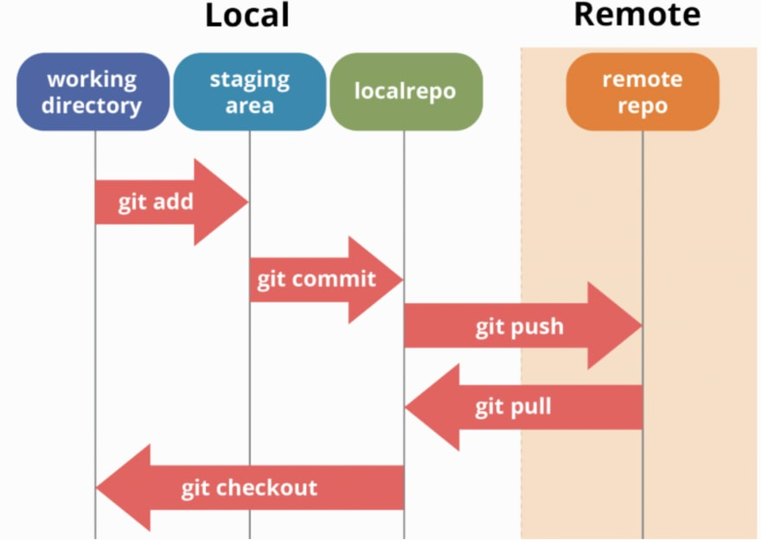
Git
Workflow
01.
git clone
02.
git pull origin master
04
03
git checkout -b new_branch_name
05
04.
git add file_name
06
05.
git commit -m "short_message"
02
06.
git push branch_name
03

Slide 13
01.
Announcements
02.
Version Control
03.
Git
04.
Python Functions Demo
05.
Q&A

Slide 14
01.
Announcements
02.
Version Control
03.
Git
04.
Python Functions
05.
Q&A

